Slide 1
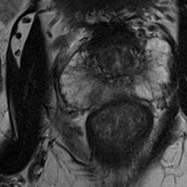
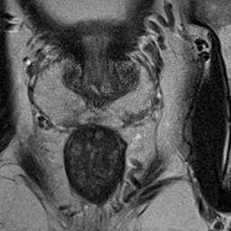
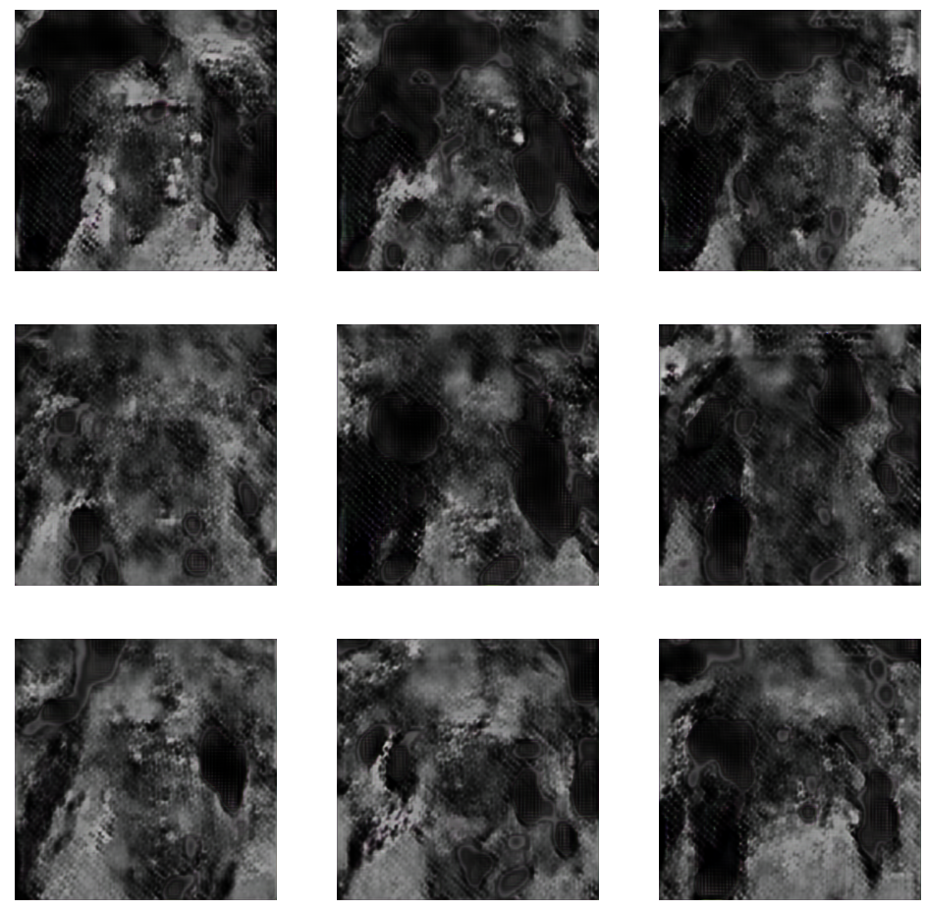
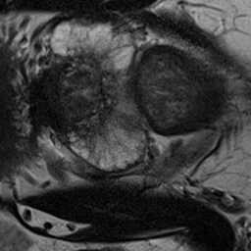
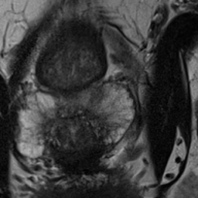
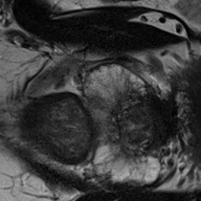
Data Augmentation to Improve the Performance of Convolutional Neural Networks Nashwa Khan , Destie Provenzano M.S., Murray Loew Ph.D. Department of Biomedical Engineering, The George Washington University, Washington, DC
Background
Results
Data augmentation is a method to create new and modified datasets. The modified datasets can be used to train and test a classifier model on images similar to real-life applications. Trans rectal ultrasound guided biopsy (TRUS) has been the standard method of prostate cancer diagnosis, but machine learning models have made prostate magnetic resonance imaging a very comparable technique. The 2017 SPIE ProstateX challenge released a series of Prostate MRI images to solicit classifier models that could identify and classify prostate cancer. Our study sought to experiment with data augmentation to determine how to improve current models based on the dataset.
Figure 1: This is an example of a T2 weighted clinically significant prostate MRI taken from the ProstateX database [1]. There were 86 clinically significant images in the training dataset. Clinically significant prostate lesions are defined as Gleason Grade 2 or greater. The arrow is showing the location of the prostate lesion.
Figure 2: This is an example of a T2 weighted prostate MRI with a benign lesion taken from the ProstateX database [1]. There were 250 images with clinically insignificant lesions in the training dataset. The arrow is showing the location of the prostate lesion.
Figure 4: This is an example of an image created using a GAN model which generates similar but specifically different datasets from the existing images.
Methods
Conclusions/Future Steps
We used a VGG-16 model for the classification of clinically significant prostate lesions on the T2-weighted MRI images from the dataset. Next, we explored various data augmentation methods to improve the performance of the model. The images in the existing dataset were rotated 90 degrees counterclockwise three times to generate three new sets of images. We also explored another method in which the images were randomly cropped to create another set of images. The models were evaluated based on the validation accuracy and loss achieved during each epoch. Accuracy can be defined as the proportion of correct predictions in the validation set and loss is the error evaluated at each epoch.
We concluded that data augmentation for MRI Prostate data is a feasible way to improve model performance compared to existing base methods. Our next steps are to explore the use of generative adversarial networks (GANs) to generate additional variations of the data to improve the training of the CNN model.
.
Figure 3: This shows the MRI image from figure 1 that was rotated 90 degrees counterclockwise three times starting from the left to generate variations of the existing images in the dataset [1].
Model | Accuracy | Loss
VGG16 (ImageNet Database) | 0.74 | -
VGG16 (ProstateX Dataset) | 0.71 | 2.16
VGG16 (Augmented ProstateX Dataset) | 0.83 | 1.22
References
K. G. Litjens, O. Debats, J. Barentsz, N. Karssemeijer and H. Huisman. "Computer-aided detection of prostate cancer in MRI", IEEE Transactions on Medical Imaging 2014;33:1083-1092.
Table 1: The original model achieved an accuracy of 0.71 and a loss of 2.16, cropped and rotated images were able to achieve an accuracy of 0.83 and a loss of 1.22.

