Slide 1
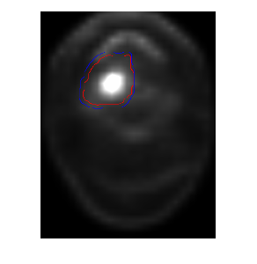
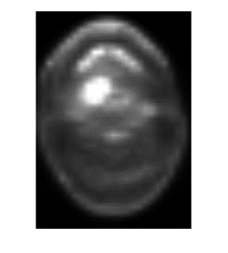
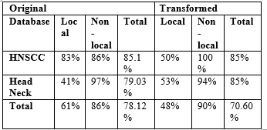
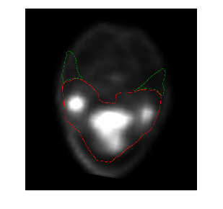
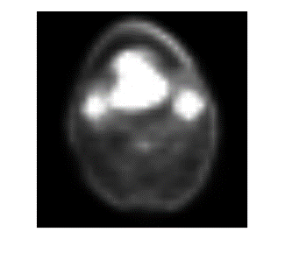
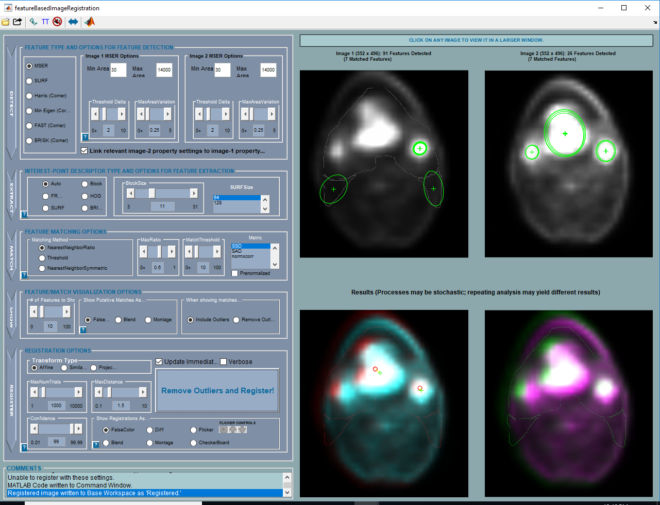
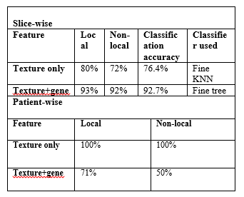
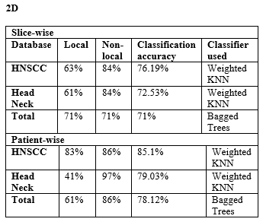
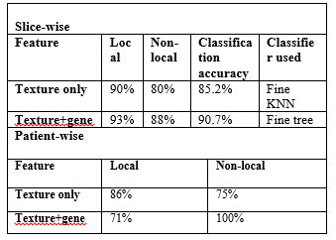
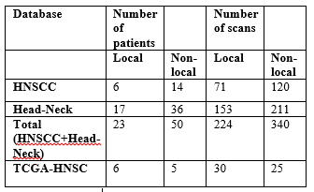
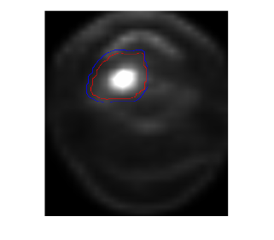
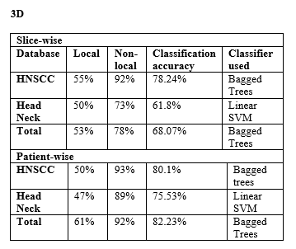
Tumor heterogeneity and gene mutation: A combined study for analysis of radiation therapy efficacy in head-and-neck carcinoma patients Apurva Singh¹, Sharad Goyal², Yuan James Rao², and Murray Loew³ Departments of ¹Electrical and Computer Engineering, ²Radiation Oncology, and ³Biomedical Engineering, George Washington University, Washington, D.C. USA
INTRODUCTION
To address the question of augmentation of the database, we decided to perform geometric transformations (translation, rotation, and reflection) on the existing images.
A comparison between 2D patient-wise classification results between original and geometrically transformed images:
The purpose of this study was to determine if the information present in the texture of tumor regions in the pre-treatment PET-CT scans of Head-and-Neck Squamous Cell Carcinoma patients can be a useful measure of the efficacy of radiation therapy in their treatment. We have now extended our study to include the gene mutation information of a group of patients to see if it can be used as an additional feature in the determination of treatment efficacy.
(a)
(b)
Fig1: (a) is the screenshot which shows the tumor region marked in the PET image and (b) shows the corresponding original PET slice as viewed in RadiAnt
Both these images are registered using the feature-based image registration app in MATLAB.
(a)
(b)
Slice-wise and patient-wise classification results for the 2D case in TCGA-HNSC patients:
Fig 3: Fig (a) shows the transformed hospital screenshot image and Fig (b) shows the transformed original RadiAnt image
DATABASES USED
We used the following databases:
HNSCC
Head-Neck-PET-CT
TCGA-HNSC
Clinical data accompanying the database are used to divide the patients into two categories: local-recurrent and non-local recurrent. The number of PET-CT scans included for each patient varied from 4 to 20 depending on the tumor size.
In our recent experiment using 11 patients from TCGA-HNSC, each patient has 3 binary features indicating the presence/absence of a mutation of expressions of these genes: TRAF3, E2F1, PIK3CA.
RESULTS
Slice-wise and patient-wise classification results for the 3D case in TCGA-HNSC patients:
An algorithm is developed in MATLAB to extract the region of the PET-CT scan that is included within the tumor boundaries indicated on the scans.
CONCLUSION
Fig 2 : The images show the tumor region marked in the PET image and the region as extracted from the original image.
Our experiments further show that identification of gene expression patterns in head and neck carcinoma patients can provide information which, when combined with tumor heterogeneity measures, can improve the therapy response prediction scores. Future studies will include patients having different tumor sites and scans of different modalities to develop a more comprehensive method of therapy personalization. in cancer patients.
METHODS
Texture analysis of the extracted tumor regions is performed in the following two ways [1]:
Treating each scan as a 2D image: Features: Laws, GLCM, Fourier, Hu’s
Treating each scan as a 3D volume:
Features: 3D GLCM, GLRLM, GLSZM, NGTDM
Tumor boundary information is present in the form of RT Structure DICOM files. These RT Structure boundaries are overlain on the PET-CT scans of the patients. Screenshots of the scans are then compared with the original database images viewed in RadiAnt DICOM Viewer.
REFERENCES
[1] Vallières, Martin, et al. "A radiomics model from joint FDG-PET and MRI texture features for the prediction of lung metastases in soft-tissue sarcomas of the extremities." Physics in Medicine & Biology 60.14 (2015): 5471.
[2] Hill, Derek LG, et al. "Medical image registration." Physics in medicine and biology 46.3 (2001): R1.

